Slide 1
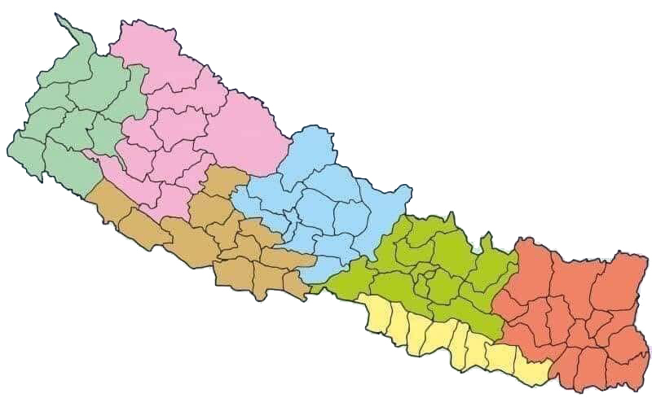
प्राविधिक शिक्षा तथा व्यावसायिक तालीम परिषद्
Institute Name: SKIPI, Dang
SKIPI
Sudur
Paschim
Karnali
Gandaki
SKIPI
Lumbini
Bagmati
.
Madhesh
1
३9औं व्यवस्थापन समिक्षा गोष्ठी-२०७8
Institute Name (शिक्षालयको नाम): Shaheed Krishna Sen Ichchhuk Polytechnic Institute
Address (ठेगाना): Ghorahi Sub Metro Politian city 17, Dang
Representative (प्रतिनिधि): Achyut Raj Dahal

Slide 2
What SKIPI is doing
A. Regular Programmes
1. Diploma Courses
DAg(Plant), DHM, D Forestry, D food & dairy, DArE, DPh, CDR, CMLT
2. Prediploma (TSLC) Courses
not till
B. Sponsor Programmes
1. Special Schlorship Courses
D food and dairy
2. Apprenticeship Courses
PDHM
3. One year professional courses
Not till date
4 Short-term Livelihood Trainings
Need, demand base
308 students are enrolled annually in regular programmes; we contribute 68.34 % (NRS. 58,425,000) subsidy fee for students annually. We provide nearly 1.5 crore NRs scholarship to Nepali youths..

Slide 3
Target Vs Achievement
Target
308 to enroll. Tender for construction, tools, equipment, water tank
Achievement 206 enrolled (80%), tender processes completed (100%)

Slide 4
Gender: Students

Slide 5
Gender: Staff

Slide 6
Activities
1. Learn, Earn, Pay
Production unit operation and managegment prodecure 2078 is approved
2. Business Incubation Centre
BIC unit is formed
Production unit is formed
Proposal is submitted
Plan is developed

Slide 7
Activities..
3. Plans, Policies
QIP Workbook is prepared, with 72 standards
4. Faculties
All faculties including part-time are trained with instructional skills
Professional Growth plan is developed by every staff
Institutionalize Peers Observation (classroom, Laboratory activities)
SKIPI SOP 2022-27 is formulated
SKIPI Master for physical premises is developed

Slide 8
Strengths
1. Workforce: Young, and energetic
2. Model: declared model TVET school of Lumbini Province
3. Climate: comparable with Pokhara valley
4. Strategic location: centre for Rukum, Salyan, Rolpa, Pyuthan, Argakhachi
5. Urban area with 2 submetro city with rural characteristics also

Slide 9
Opportunities, Challenges
Construction: very slow
Number of buildings: low
Number of staffs: low
Number of tools, equipment: low
Number of furniture: low
Number of students: high, higher, very high
Donors in TVET are available

Slide 10
धन्यवाद !
Requesting for feedback and queries…

